Slide 1
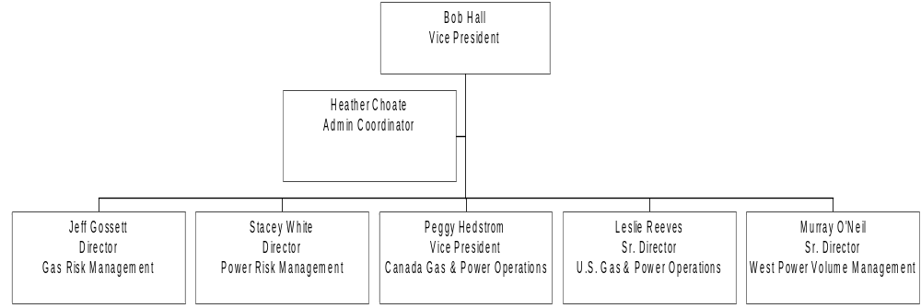
NETCO - Energy Operations

Slide 2
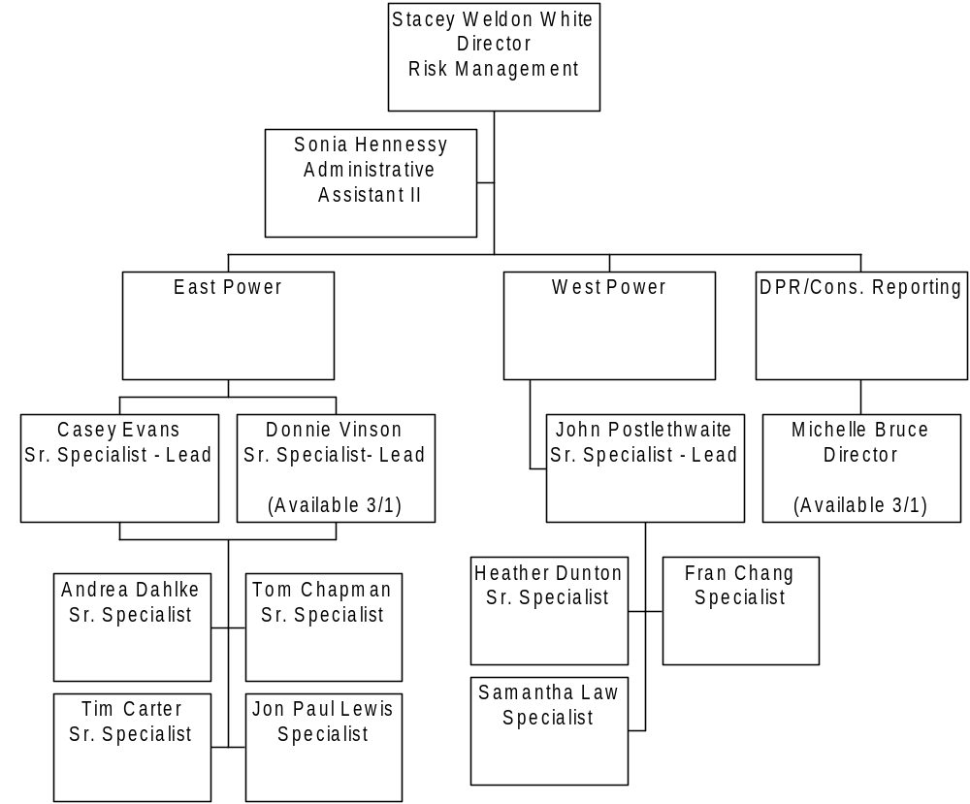
Power Trading Operations Risk Management
Power Trading Operations Risk Management

Slide 3
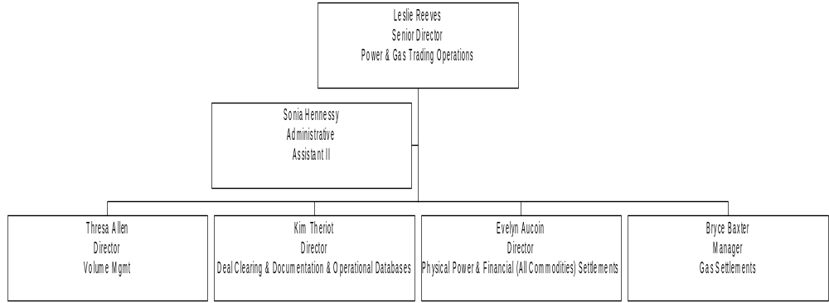
Energy Operations Power & Gas Trading

Slide 4
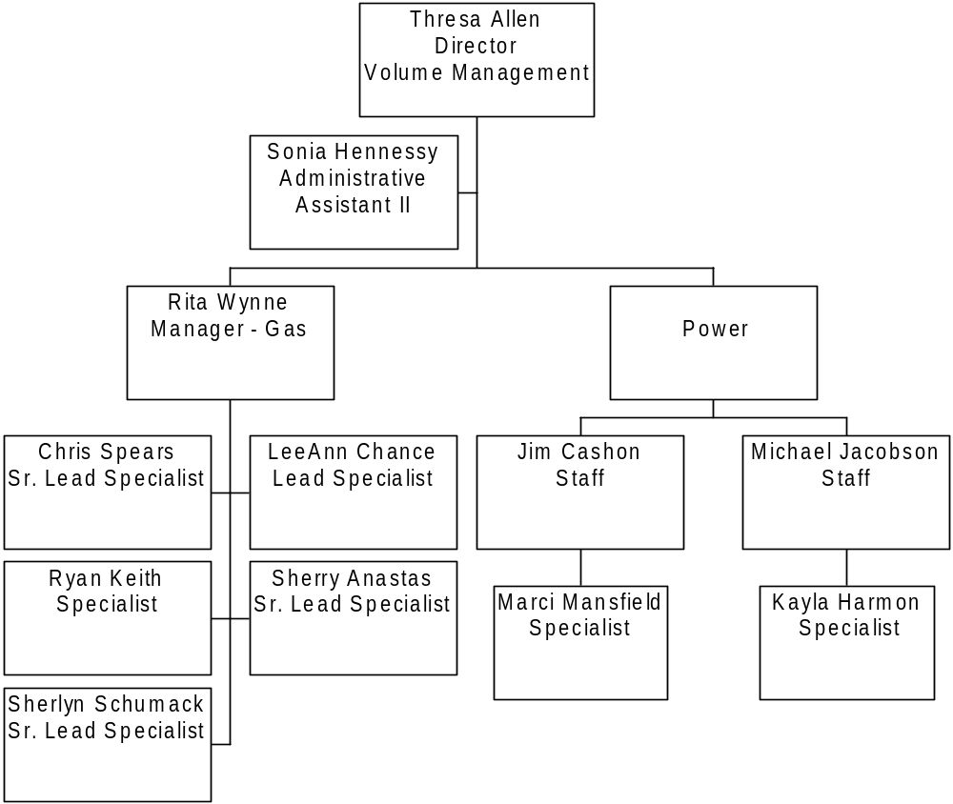
Volume Management
Gas & Power

Slide 5
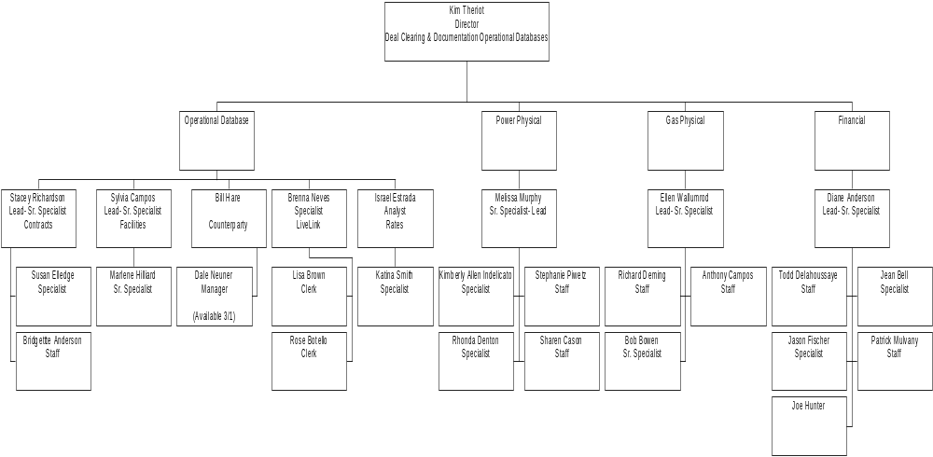
Deal Clearing & Documentation
Operational Databases

Slide 6
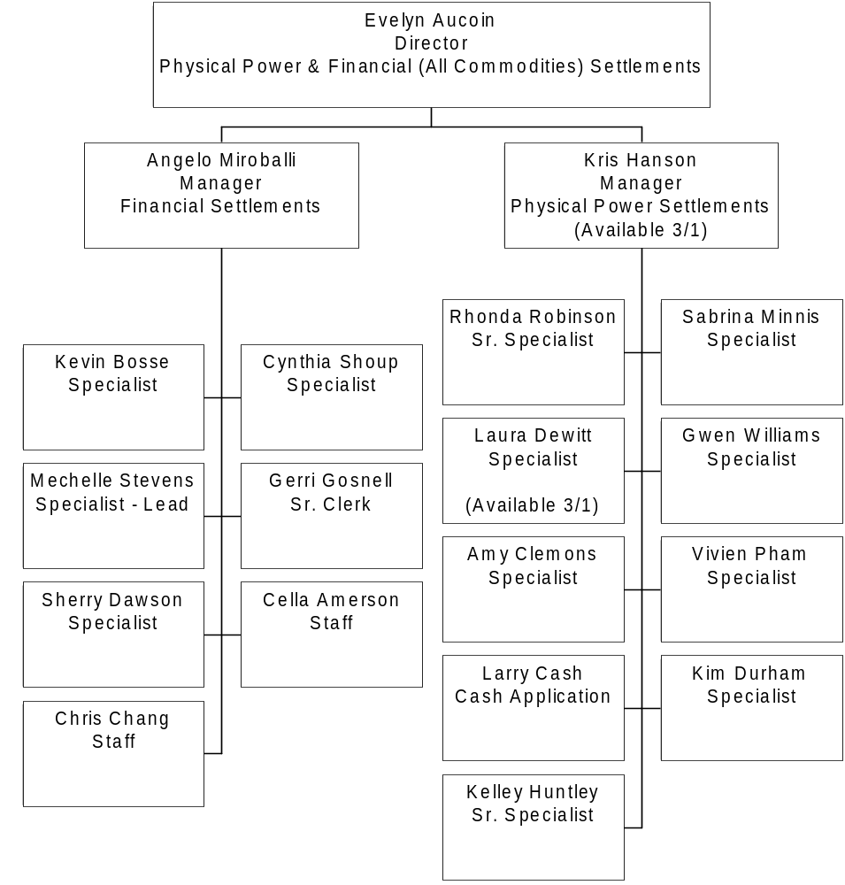
Physical Power & Financial (All Commodities) Settlements

Slide 7
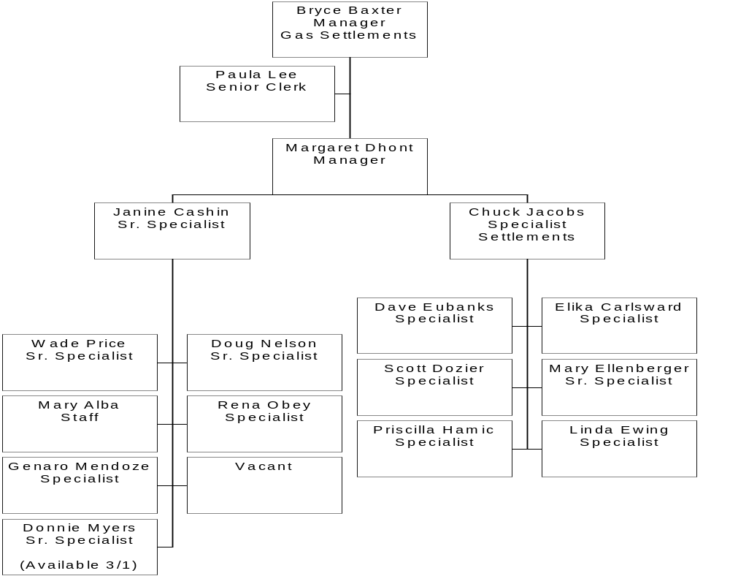
Physical Gas Settlements

Slide 8
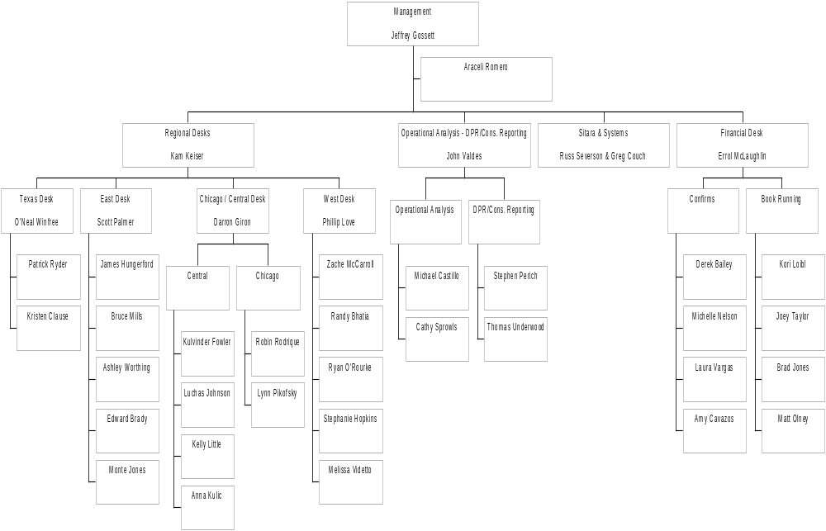
Gas Risk Management

Slide 9
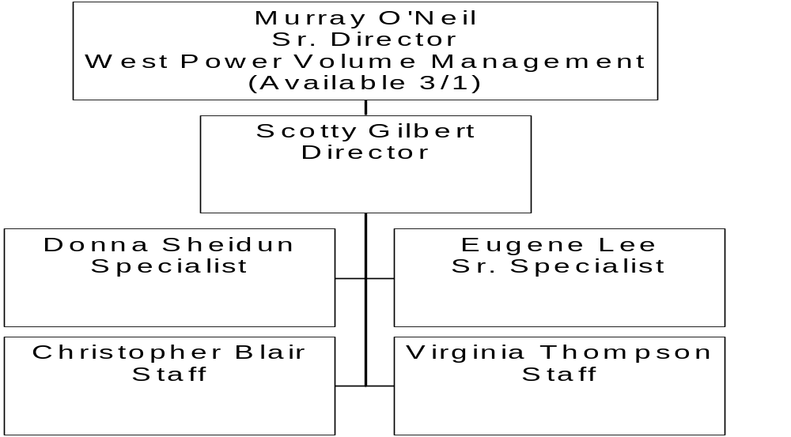
West Power Volume Management

